Slide 1
US Accident Trends from 2016-2023
By: Joe Coyne

Slide 2
Outline
Introduction
Data Overview
Initial Data Exploration
SARIMA Model
Regression Model
Further Data Investigation
Conclusion

Slide 3
Introduction
Dataset originates from two papers by researchers at Ohio State University
About 7.7 million accident records from a countrywide car accident dataset
Some variables include state, time zone, temperature, weather, features of the road (exits, roundabouts, etc.)
Data collected from February 2016 through March 2023 using MapQuest Traffic and Microsoft Bing Map Traffic
APIs from these sites are captured using various entities like departments of transportation, law enforcement agencies, and traffic cameras and sensors
Data was pulled every 90 seconds from 6am-11pm, and every 150 seconds from 11pm-6am
Notes:
API = Application Programming Interface
For the purposes of this project and to aid in the time series analysis, I consolidated the data into 2,572 different data points based on the unique dates of accidents being recorded and noted how many accidents there were per day

Slide 4
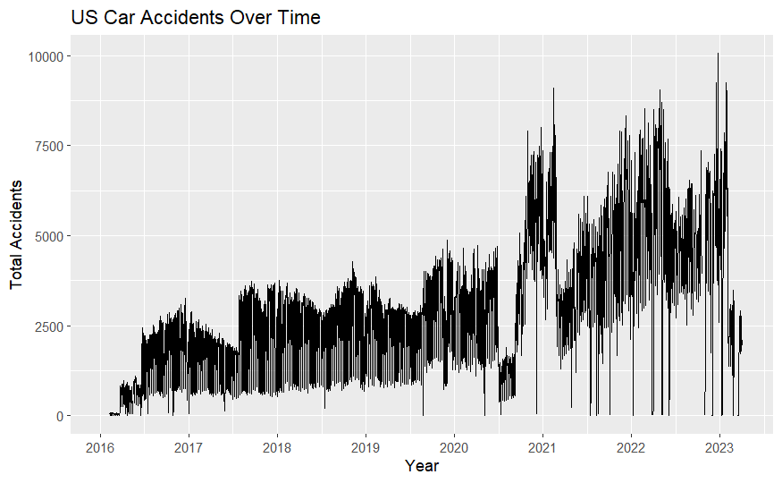
Data Overview
There seems to be a dip in total accidents around June 2020, with a stark jump in September of 2020
March of 2021 seems to return to a similar trend as the data before the 2020 jumps
Finally, there is a steep decrease in accidents in 2023
Notes:
Steep decrease in 2023, but this might be because only 3 months of data had been collected at the time of this study. Maybe some data is collected every 6 months for the whole 6 month period
Lack of constant variance

Slide 5
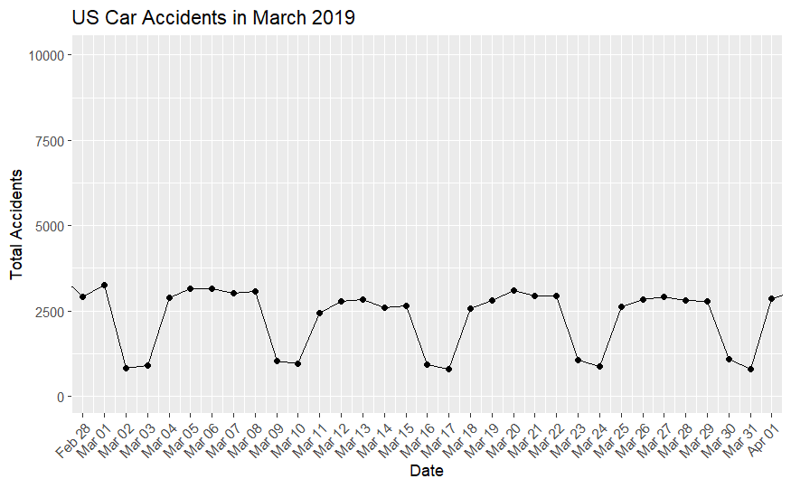
Data Overview
Looking at the weekly patterns in March 2019, we see a lower amount of total accidents on the weekend than we do during the week
Notes:
Less accidents on weekend either because of less accident tracking, or maybe less people are driving to work and school

Slide 6
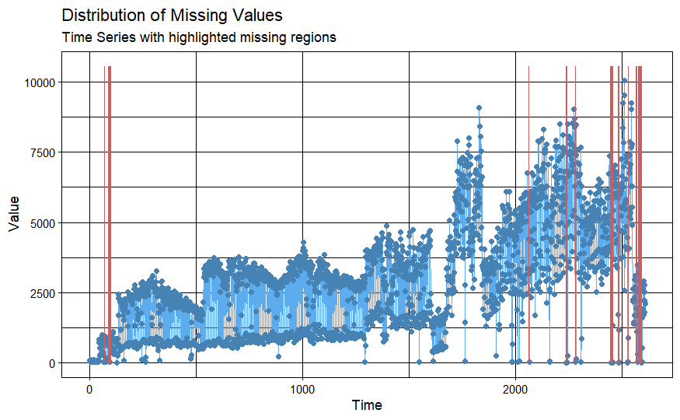
Initial Data Exploration
38 total missing values
Notes:
Imputed these missing values using the na_interpolation function

Slide 7
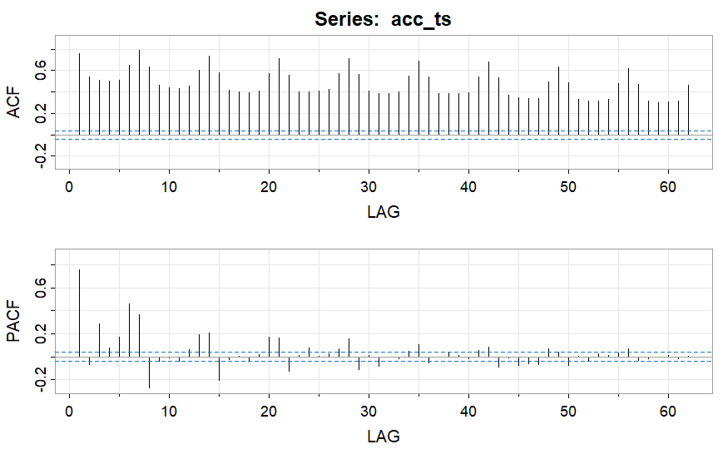
Initial Data Exploration
Initial spike in PACF at Lag 1
Spikes in ACF every 7 lags, indicating a weekly trend (seasonal trend of period 7)

Slide 8
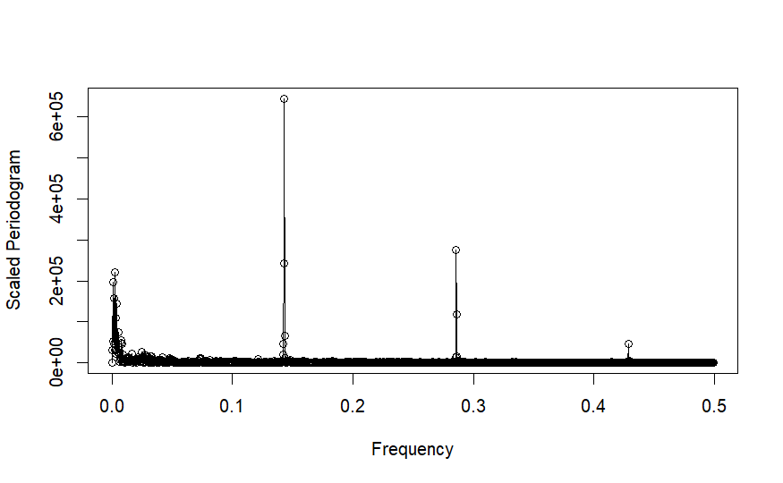
Scaled Periodogram
Looking at the scaled periodogram, we see the frequency of 1/7 have the largest value, with 2/7 having the next highest, and so on
Indicates seasonality of period 7

Slide 9
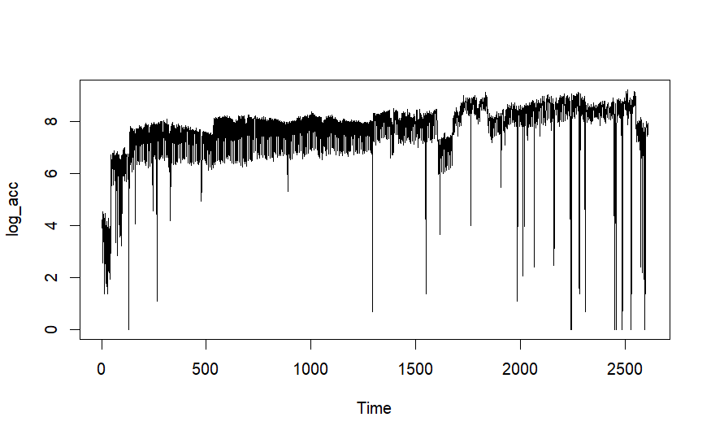
Initial Data Exploration
Log transformation of data reduces variability by a large margin
Will want to investigate the downward spikes, but a lot better time series plot than the original
Notes:
Most of the downward spikes in the log_acc plot occur when the number of accidents are less than 10, thus the log is about 2 or less.
This could be because of two reasons, one that there were just an unusually low number of accidents that day, or more likely, some of the recording was done incorrectly. Maybe the total number of accidents was lost, so a placeholder of 1 was used, or maybe some of the traffic sensors and cameras were down for the day. Maybe some weekends have less accidents reported if the departments of transportation / law enforcement agencies are closed or have limited staffing.

Slide 10
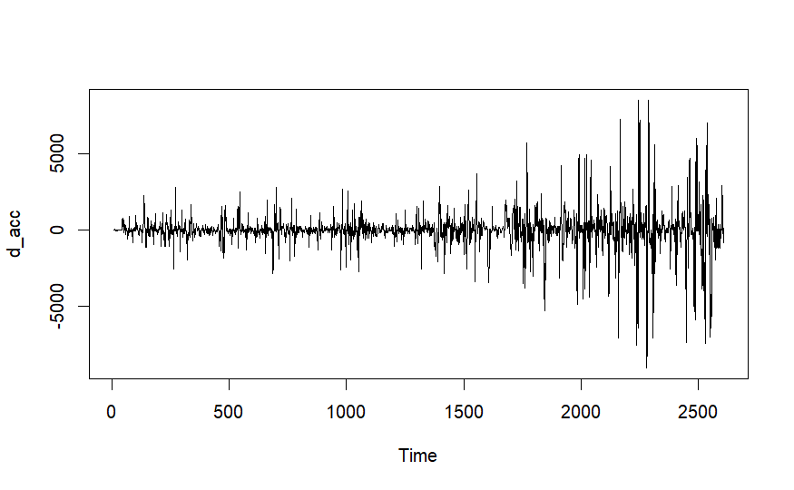
Initial Data Exploration
Differenced data removes trend, but there is still a clear violation of constant variance
We ran some initial SARIMA functions on this data, but further transformed data was used to find better SARIMA models
Notes:
Differenced at lag 7

Slide 11
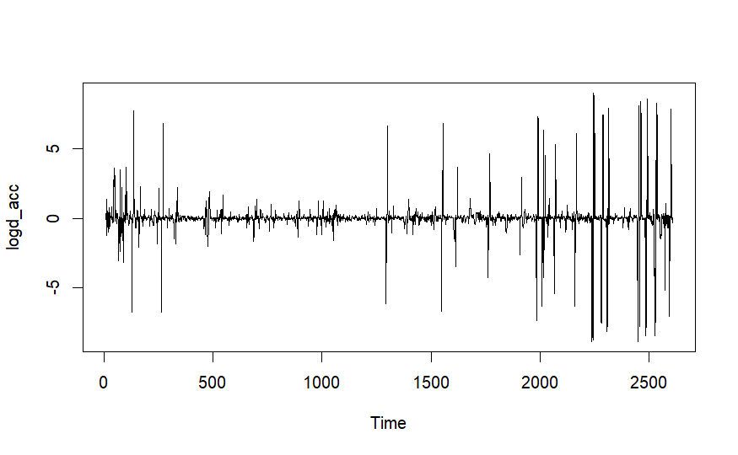
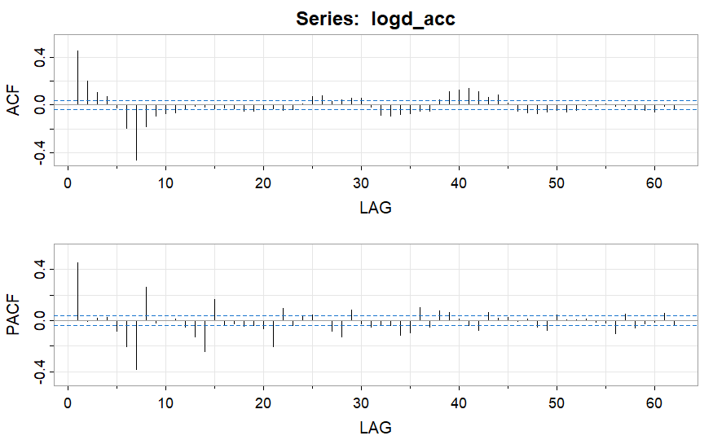
SARIMA Model
Differenced the log time series at lag 7 to remove the trend and improve the data’s stationarity
The spikes in variability occur at the same places as before in the log plot, so investigating the previous spikes will help our understanding here too
Notes:
- Large values at lag 1 and 7 in both plots. There are also large values at multiples of 7 in the PACF plot
- We will fit a SARIMA(5,0,4,1,0,1) model with s=7 on this data

Slide 12
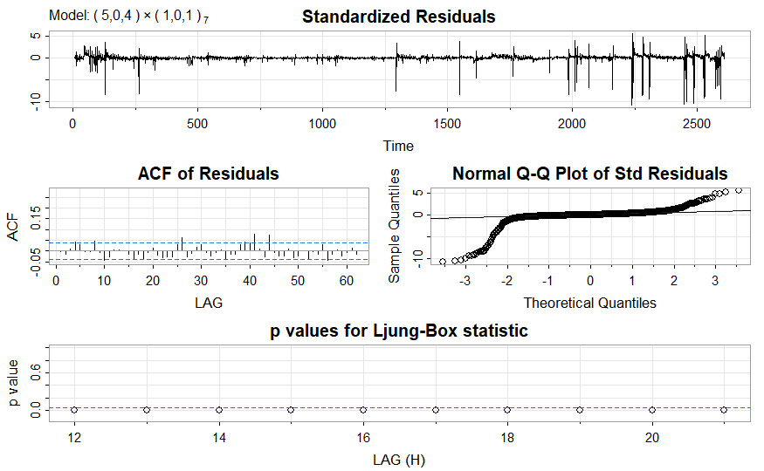
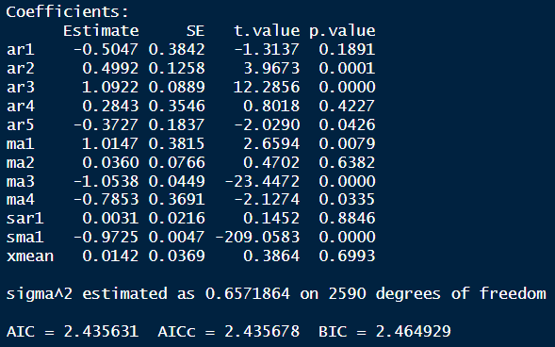
SARIMA Model
Notes:
Still have the issue of non-constant variance
Normal Q-Q plot is still very concerning
Most of the parameters are significant
Chose to keep the sar1 parameter in the model because this help the forecasted observations retain the weekly pattern observed where there were less accidents on the weekend
ACF and Ljung-Box plots look good

Slide 13
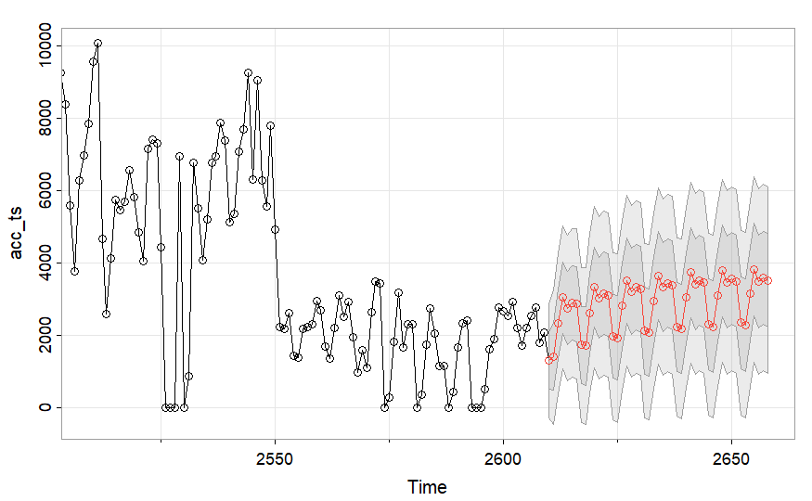
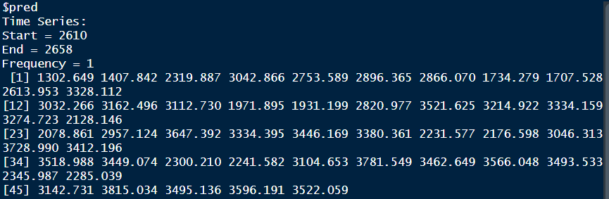
SARIMA Model: Forecasting
Retains the weekly patterns
Notes:
These forecasts seem reasonable because the next data point is April 1 2023, a Saturday – the weekend/weekday pattern is maintained

Slide 14
Regression Model
These 4 circled sections of the plot seem to be different time series, so we created different indicators for them
The first dip is presumable from COVID, although it’s about 3 months after lockdowns started
Notes:
We also tested to see if another indicator around June of 2022 was significant, but we found it wasn’t

Slide 15
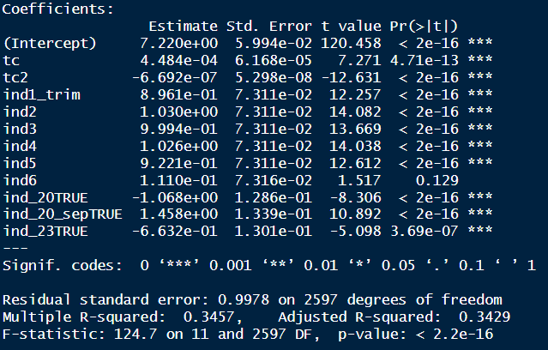
Regression Model
We were interested in the following variables:
Time (centered)
Time squared (centered)
Indicators for day of the week (ind1 through ind6)
Whether the data was from post-June 2020
Whether the data was from post-September 2020
Whether the data was from post-January 2023
Notes:
We also tested to see if indicators around March of 2021 and June of 2022 were significant, but we found they weren’t
We also tested if a sine or cosine function would be significant in predicting total accidents per day, but it wasn’t
We tested interaction terms too, but they weren’t significant

Slide 16
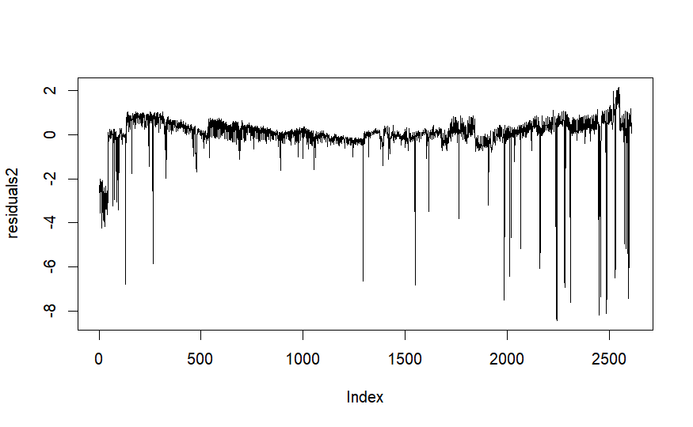
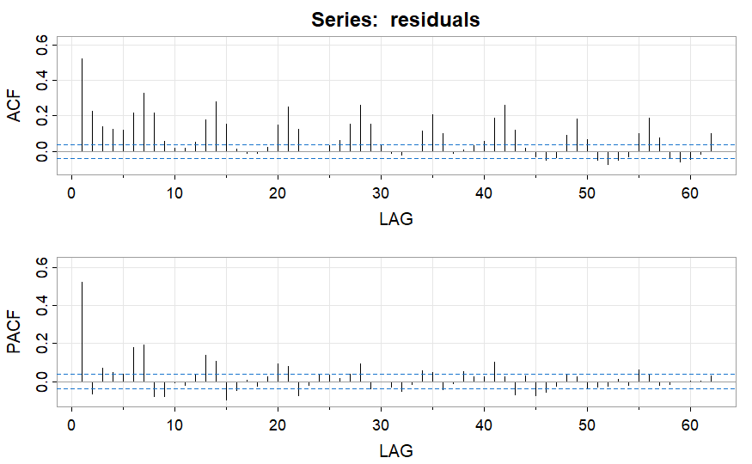
Regression Model
Notes:
- Once again, there is a large spike at lag 1 in the PACF plot
- There are spikes at lag 7 and all of the 7 multiples in the ACF plot

Slide 17
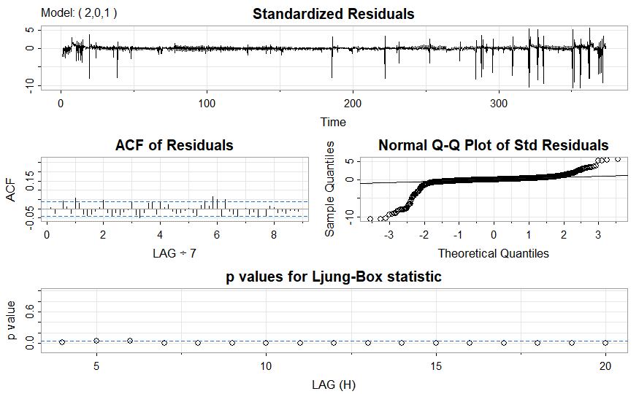
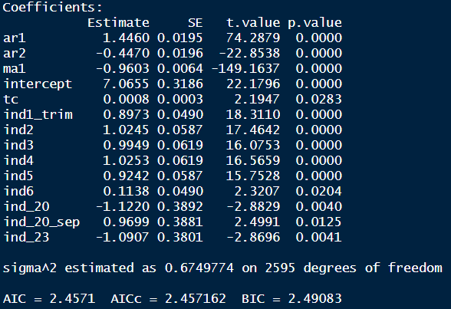
Regression Model
Notes:
Still have the issue of non-constant variance
Normal Q-Q plot is still very concerning
All of the parameters are significant
ACF and Ljung-Box plots look good
Slightly higher AIC than the model without indicators

Slide 18
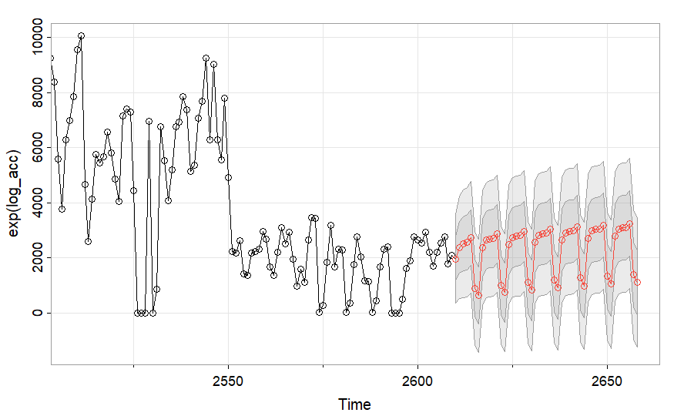
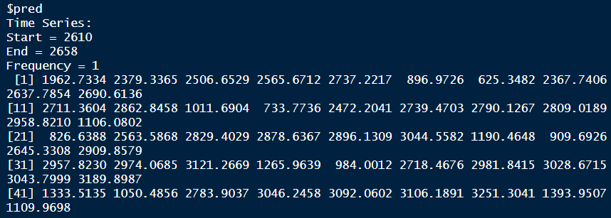
Regression Model: Forecasting
Notes:
The first SARIMA model is better since this regression model has the dip in accidents on a Thursday and Friday instead of Saturday and Sunday

Slide 19
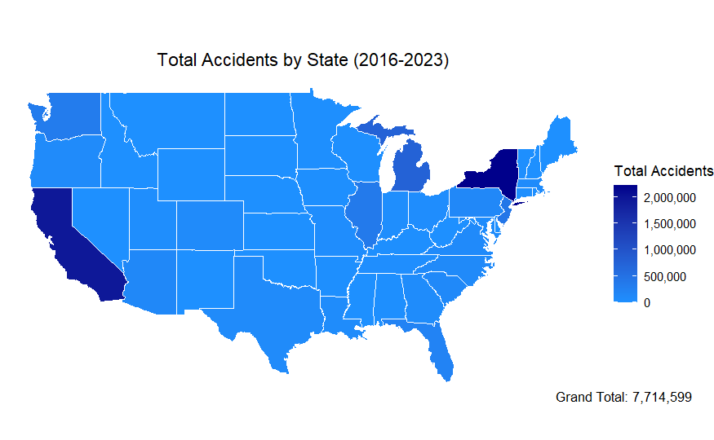
State Accident Trends
Notes:
New York and California have the most total accidents from 2016-2023 by far, with New York at 2.2 million and California at 1.9 million. Michigan (755,720), New Jersey (428,285), and Illinois (364,048) have the next highest.
Delaware, Maine, Mississippi, New Hampshire, North Dakota, Oklahoma, and South Dakota all have 0 reported total accidents. West Virginia only has 7 reported total accidents over this same time frame. These seems unlikely and are probably reporting issues.

Slide 20
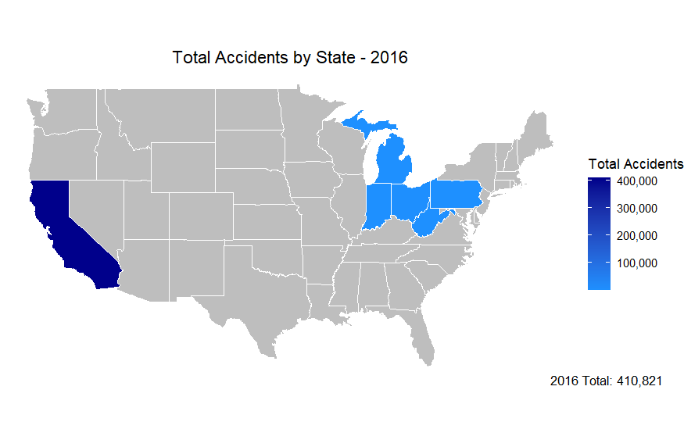
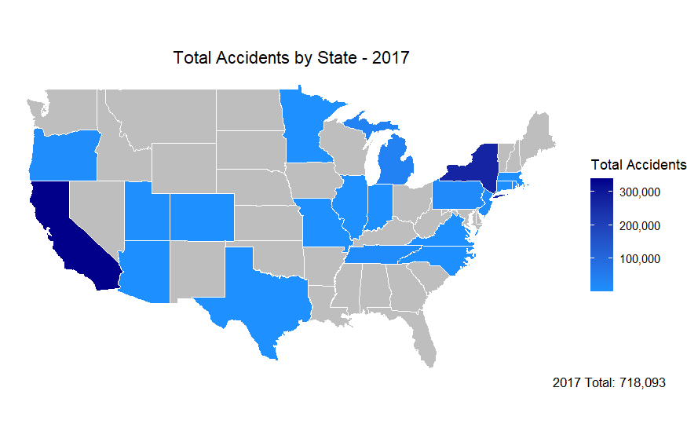
State Accident Trends

Slide 21
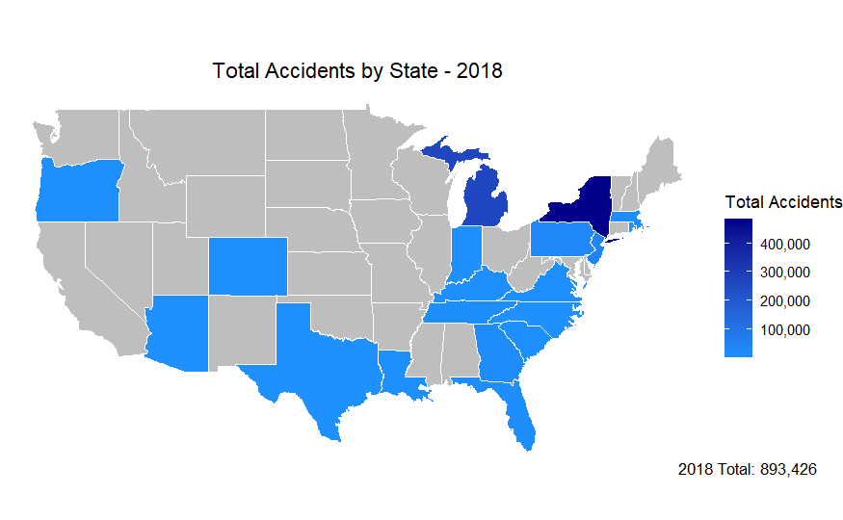
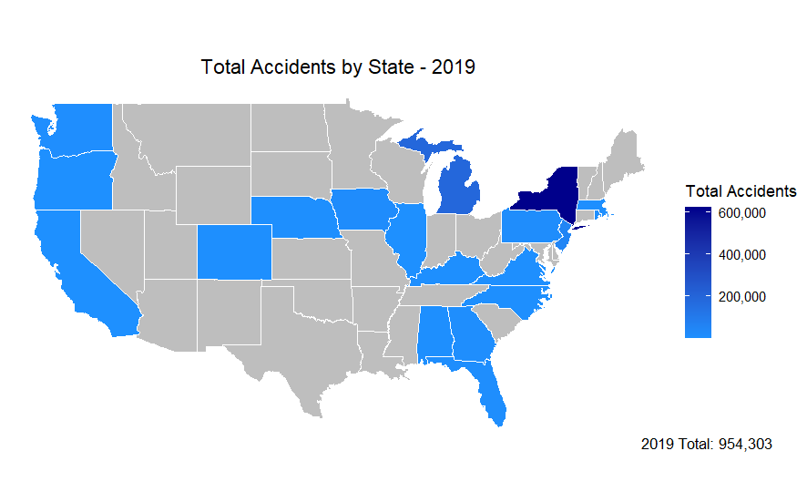
State Accident Trends

Slide 22
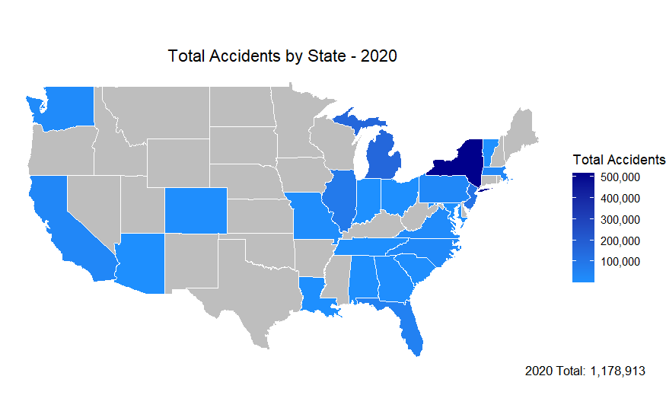
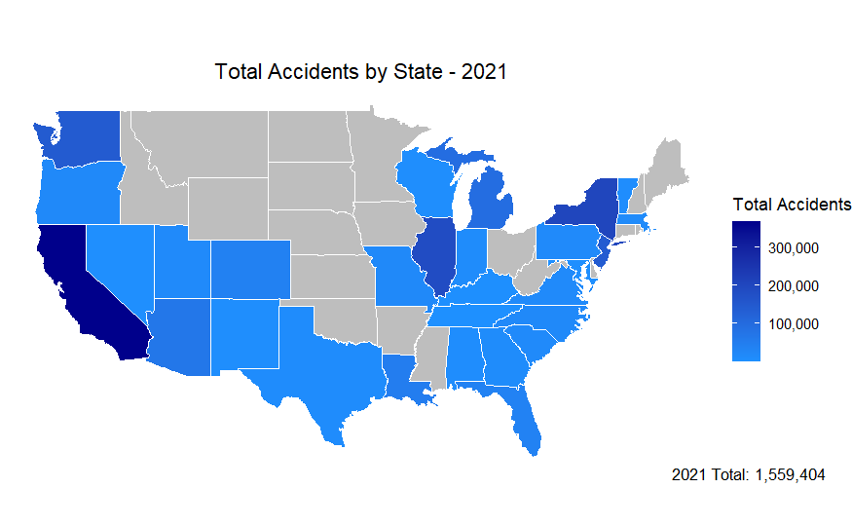
State Accident Trends

Slide 23
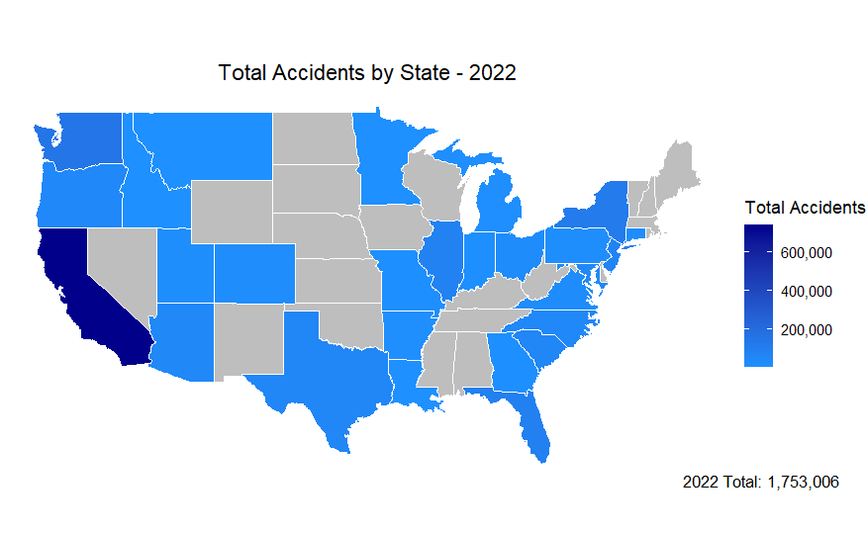
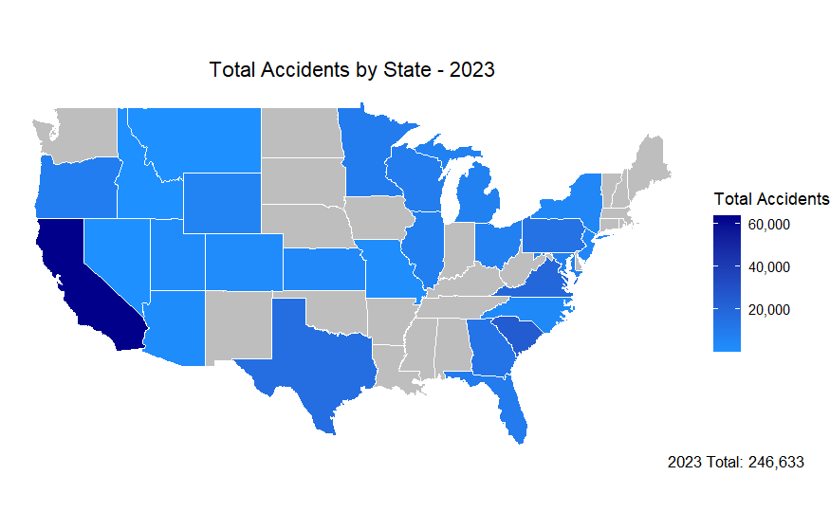
State Accident Trends

Slide 24
Limitations and Further Considerations
Data collection had many dates with either no accidents or 1 accident (likely a placeholder) recorded
Many states had years where no accidents were recorded
In fact, Delaware, Maine, Mississippi, New Hampshire, North Dakota, Oklahoma, and South Dakota all have 0 reported total accidents
The many jumps in accidents resulted in very concerning Normal Q-Q plots
If more time, run SARIMA model only on states where there is data for each year
Explore more of the other predictors (like temperature, weather conditions, time zone, etc.) and their relationships with number of daily accidents, as well as interactions between predictors

Slide 25
Conclusion
The SARIMA (5,0,4,1,0,1) model with s=7 and no indicators was the best at predicting total daily accidents
Weekdays tend to have more accidents than the weekend
As time goes on and driving becomes more popular, more accidents will tend to occur
California and New York seem to have the most accidents in the United States
Overall, states that are more populated and have more drivers will have more accidents

Slide 26
Thank you
Any questions?

